Slide 1
Genriver Python version
Ha Van Tu

Slide 2
Table of content
About me
Genriver stella problems
Genriver Python’s coming
Comparison
Demo

Slide 3

1. About me
Ha Van Tu – programmer
27 years old
Married
Projects: FALLOW, GenRiver

Slide 4
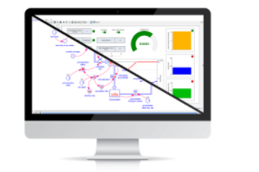
2. GenRiver stella
Pros
Cons
Worldwide stella from iThink
Easy DnD components to model, simulate and analyze the complex system
Expensives => hard to public the model to various users
Not work for map data => hard to extend and connect with other map-based model.

Slide 5


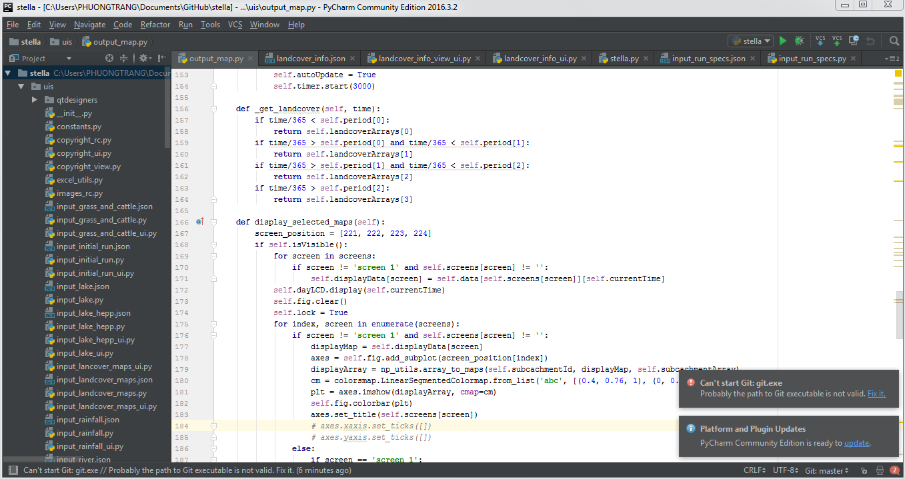



3. GenRiver Python
Pros
Cons
Consist of open sources: Python, Numpy, Matplotlib, Gdal…
Work with various data, include map => easily to link with other map-based SW
FALLOW and GenRiver both have Python version
Code-based program => not as easily to modify as stella model

Slide 6
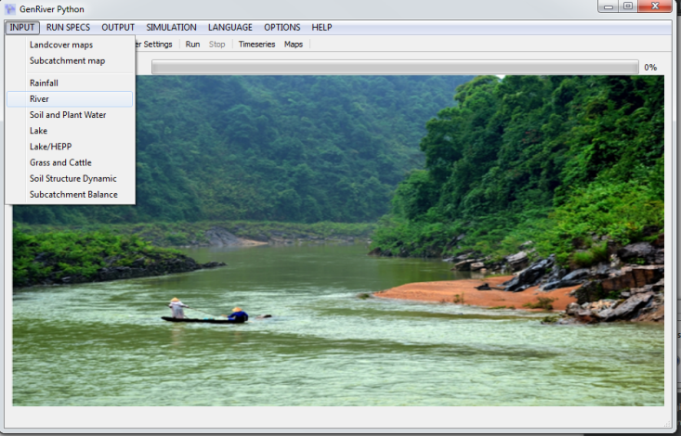
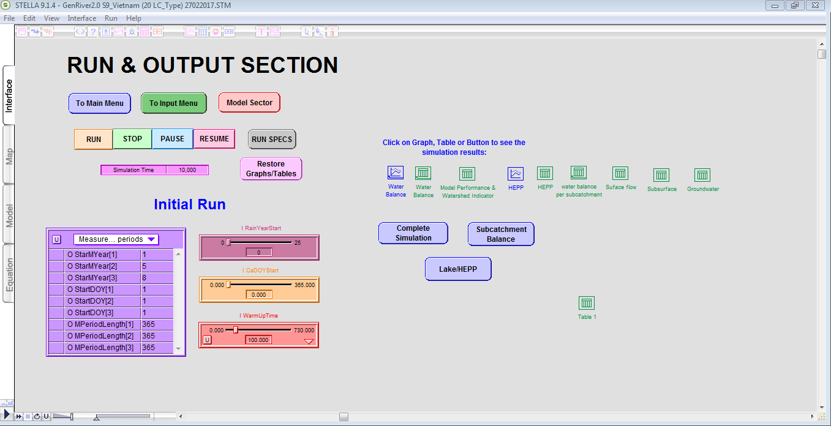
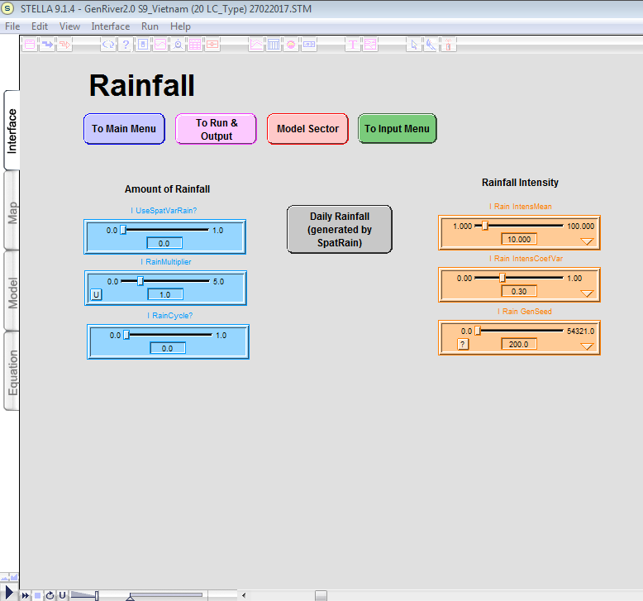
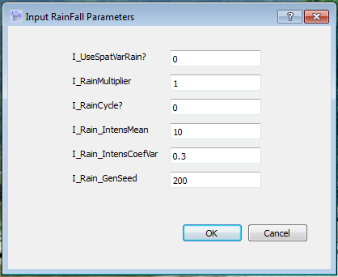
4. Comparisons
GenRiver Python
GenRiver stella

Slide 7
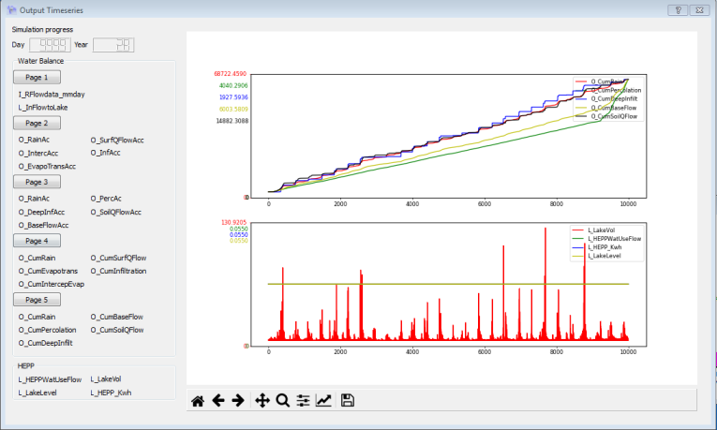
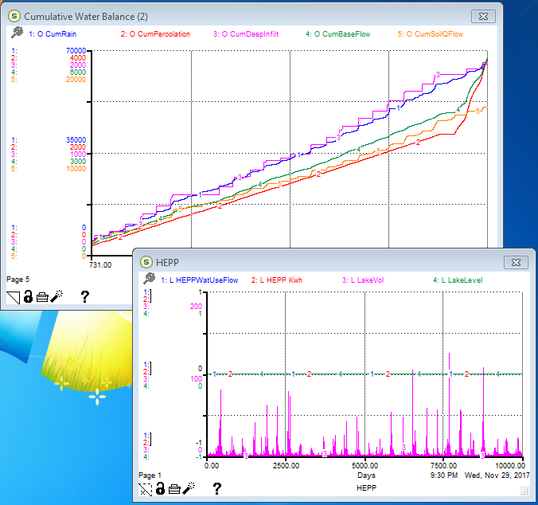
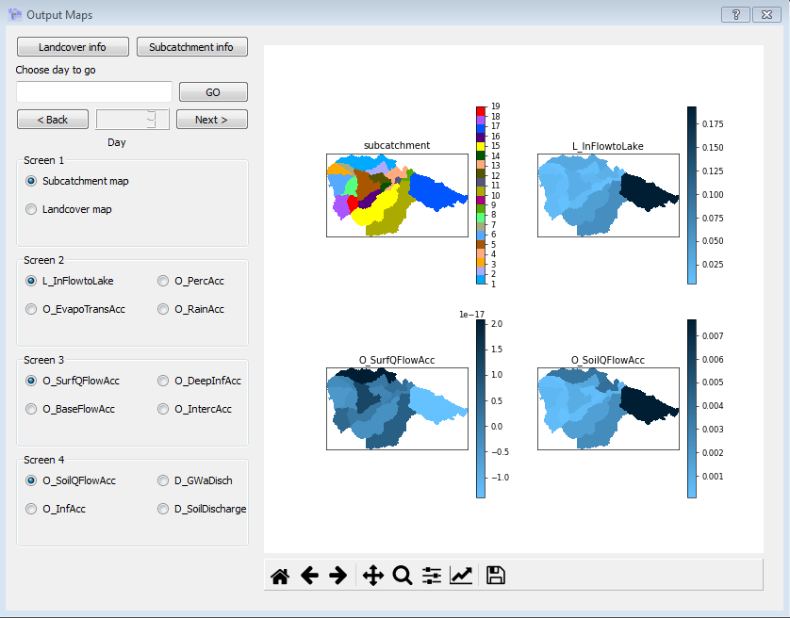
4. Comparison (2)
GenRiver Python
GenRiver stella

Slide 8
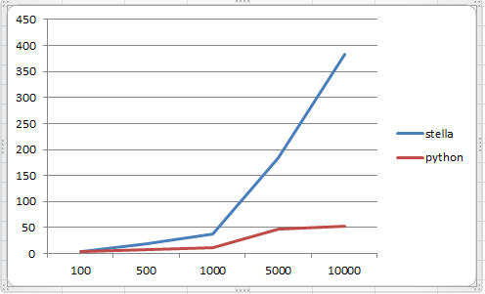
4. Comparison (3)
GenRiver Python
GenRiver stella
Time simulation(s) related to number of loops

Slide 9
Demo

Slide 10
Thank you!

